Slide 1
UAV-1
UAV-2
FD-GS

Slide 2
Uplink UAVs
Downlink UAVs
FD-GS

Slide 3
Downlink UAV-j
Uplink UAV-i
FD-GS

Slide 4
Downlink UAV
Uplink UAVs
FD-GS

Slide 5
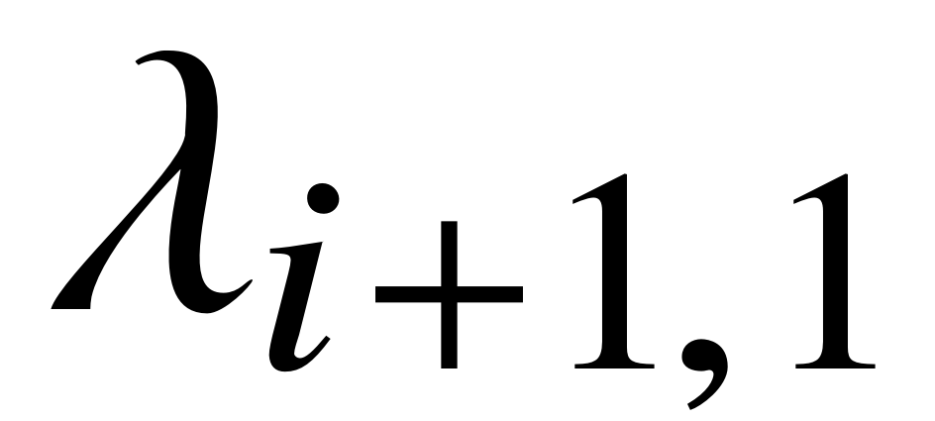
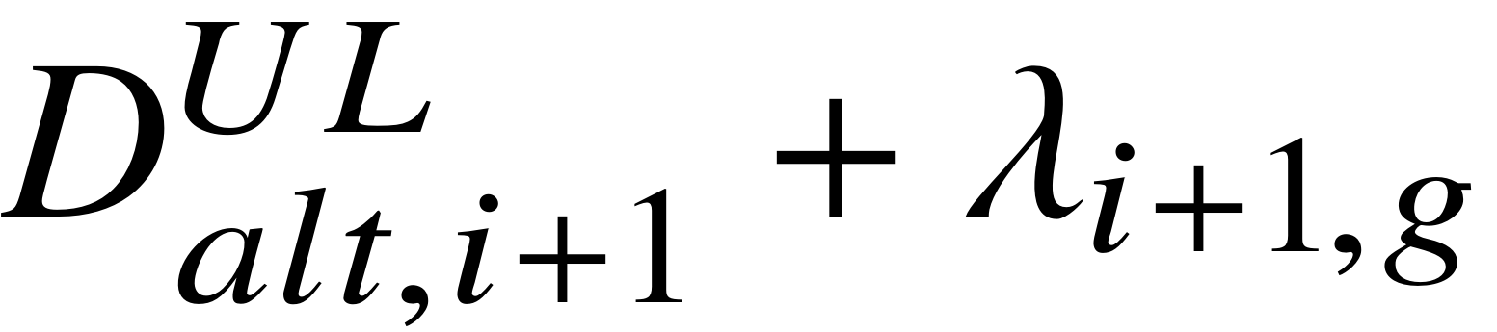
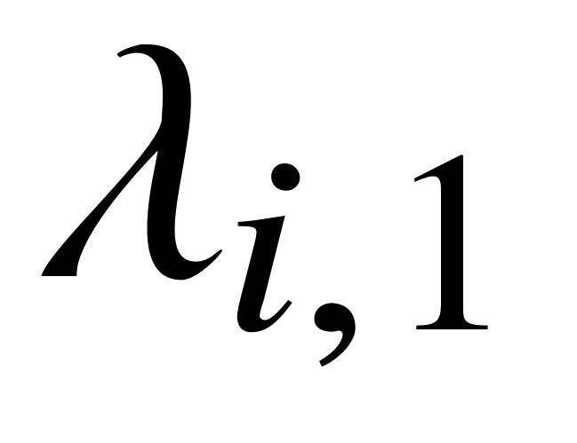
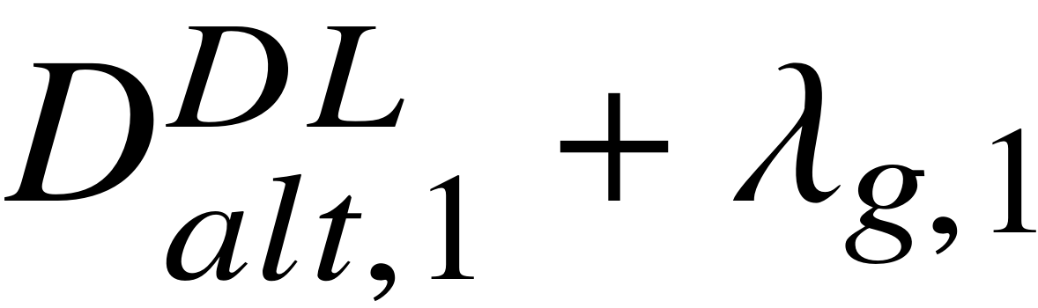

UL UAV-(i+1)
DL UAV-1
UL UAV-i
FD-GS

Slide 6
UL UAV-(i+1)
UL UAV-i
FD-GS

